Slide 1
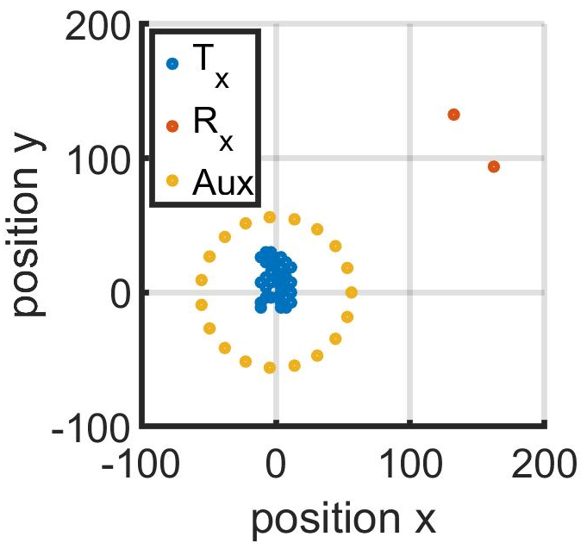
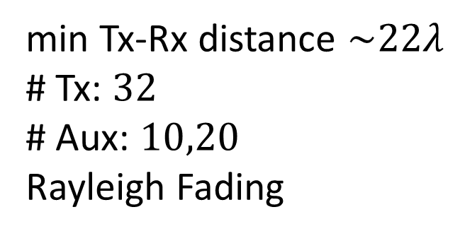
(x,y)-Position of Agents and Receivers
min Tx-Rx distance $\sim 22λ$
# Tx: $32$
# Aux: $10,20$
Rayleigh Fading

Slide 2
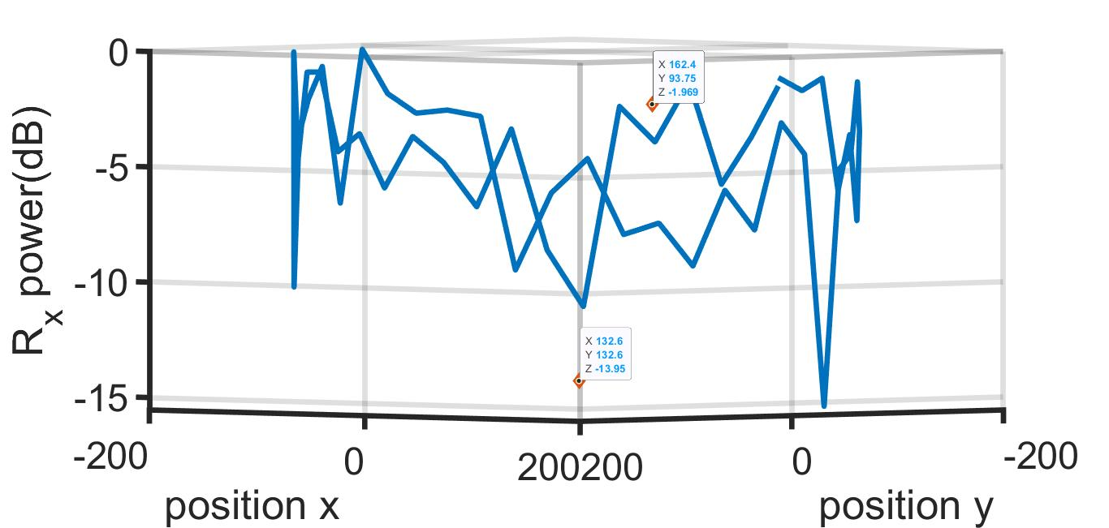

Feedback from $10$ Aux. Nodes
Mean Rx power at $50$ different directions $−4.5 dB$

Slide 3
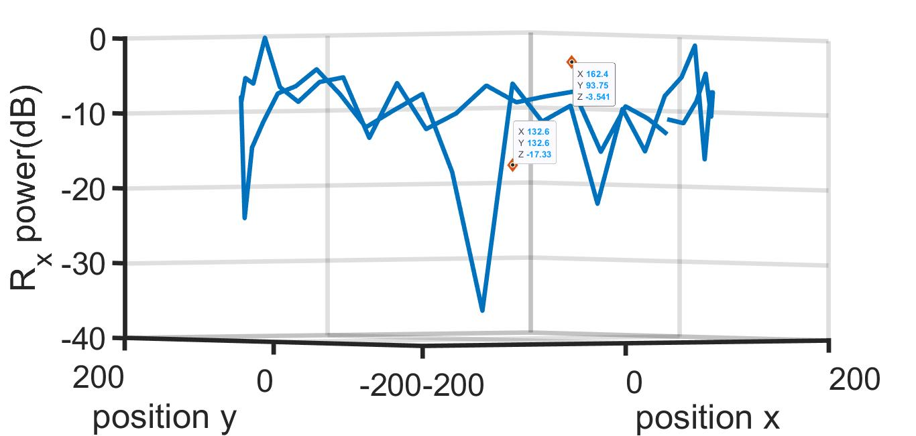

Feedback from $20$ Aux. Nodes
Mean Rx power at $50$ different directions $−9.7 dB$

